Slide 1
Interactive Personal Portfolio Website Using HTML,CSS AND JAVASCRIPT
CAPSTONE PROJECT
Presented By:
Name:-Brijesh Rath
College:-Gita Autonomous College
AICTE ID:-STU6797b40e02a051737995278
Department:-CSE(AI & ML)

Slide 2
OUTLINE
Problem Statement
System Development Approach
Algorithm & Deployment
Result
Conclusion
Future Scope(Optional)
References

Slide 3
Problem Statement
Traditional resumes are static and lack interactivity.
Recruiters find it difficult to evaluate technical skills effectively.
Conventional CVs cannot showcase live projects or creativity.
Personal branding opportunities are limited in paper-based resumes.
There is a need for a dynamic, responsive, and modern portfolio platform.

Slide 4
System Approach
HTML5 – Structure
CSS3 – Styling & Responsive Layout
JavaScript (ES6) – Interactivity
AnimationsGoogle Fonts (Montserrat, Poppins) – Modern typography
GitHub Pages – Hosting the portfolio
Design Approach:
Clean and user-friendly interface
Mobile-responsive design
Modular separation of HTML, CSS, and JS files

Slide 5
Algorithm & Deployment
Portfolio Structure Creation
Define portfolio sections such as Home, About, Skills, Projects, and Contact.
Frontend Design
Layout using HTML and CSS for responsive and clean structure.
Interactive Features
Add smooth scrolling, typing effect, and hover animations using JavaScript.
Content Integration
Insert personal details, skills with progress bars, and project showcase cards.
Navigation Flow
Implement navigation bar links with scroll-to-section functionality.
Testing
Verify responsiveness across devices and browsers for compatibility.
Deployment
Host project files on GitHub repository with version control.
Hosting
Deploy the portfolio using GitHub Pages for free and easy access.

Slide 6
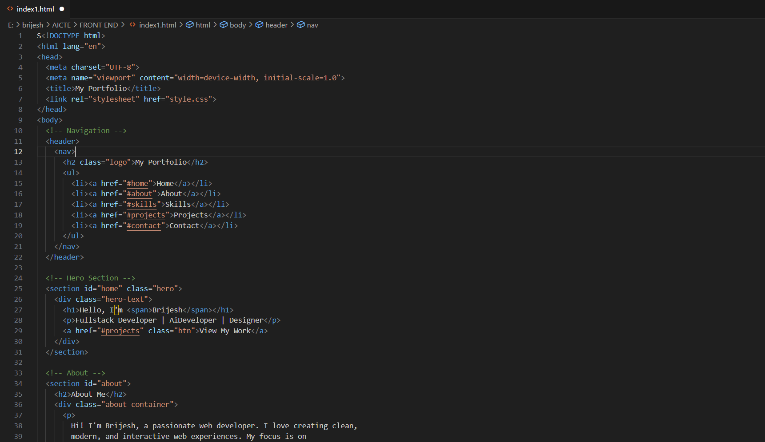
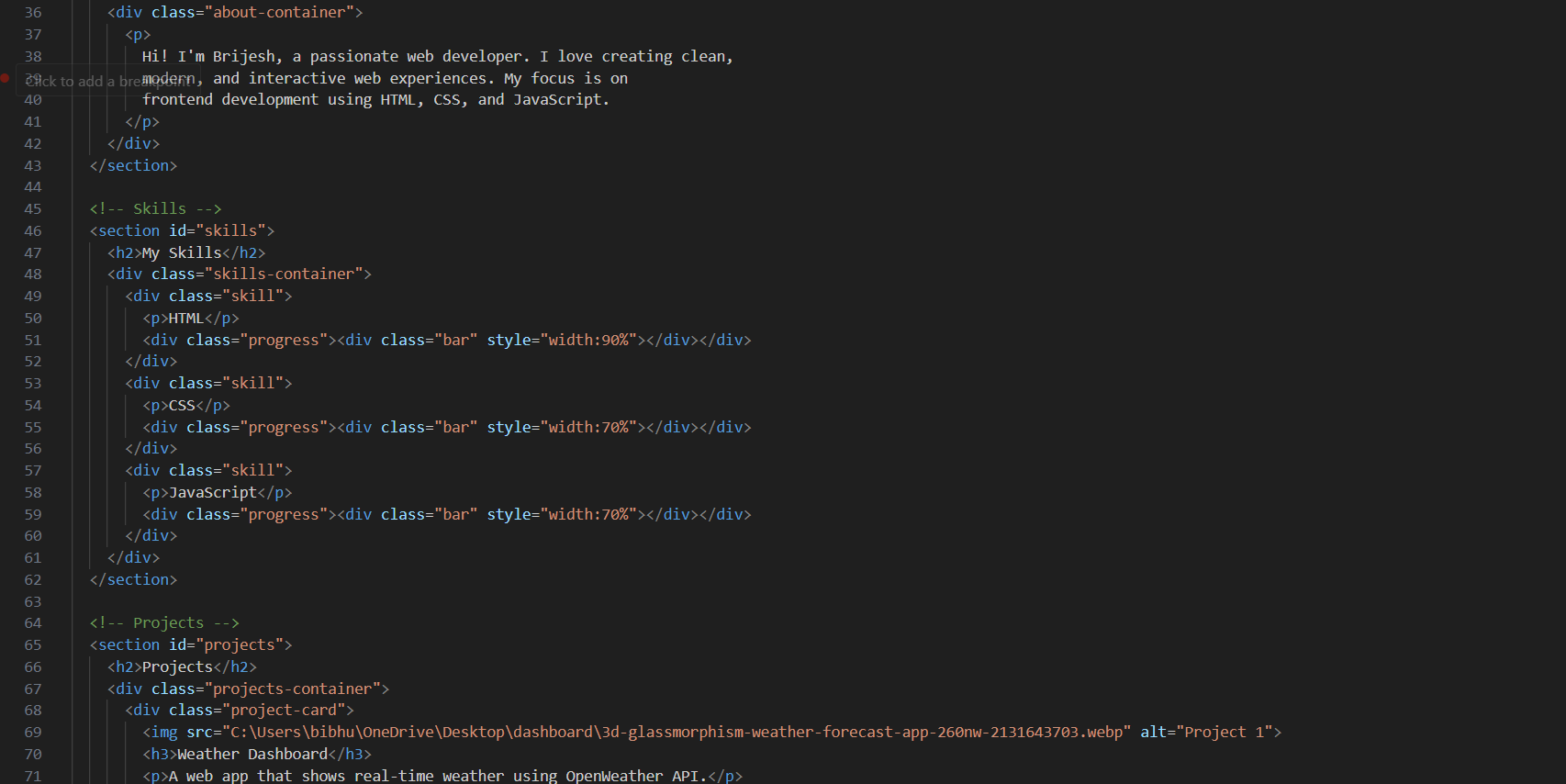
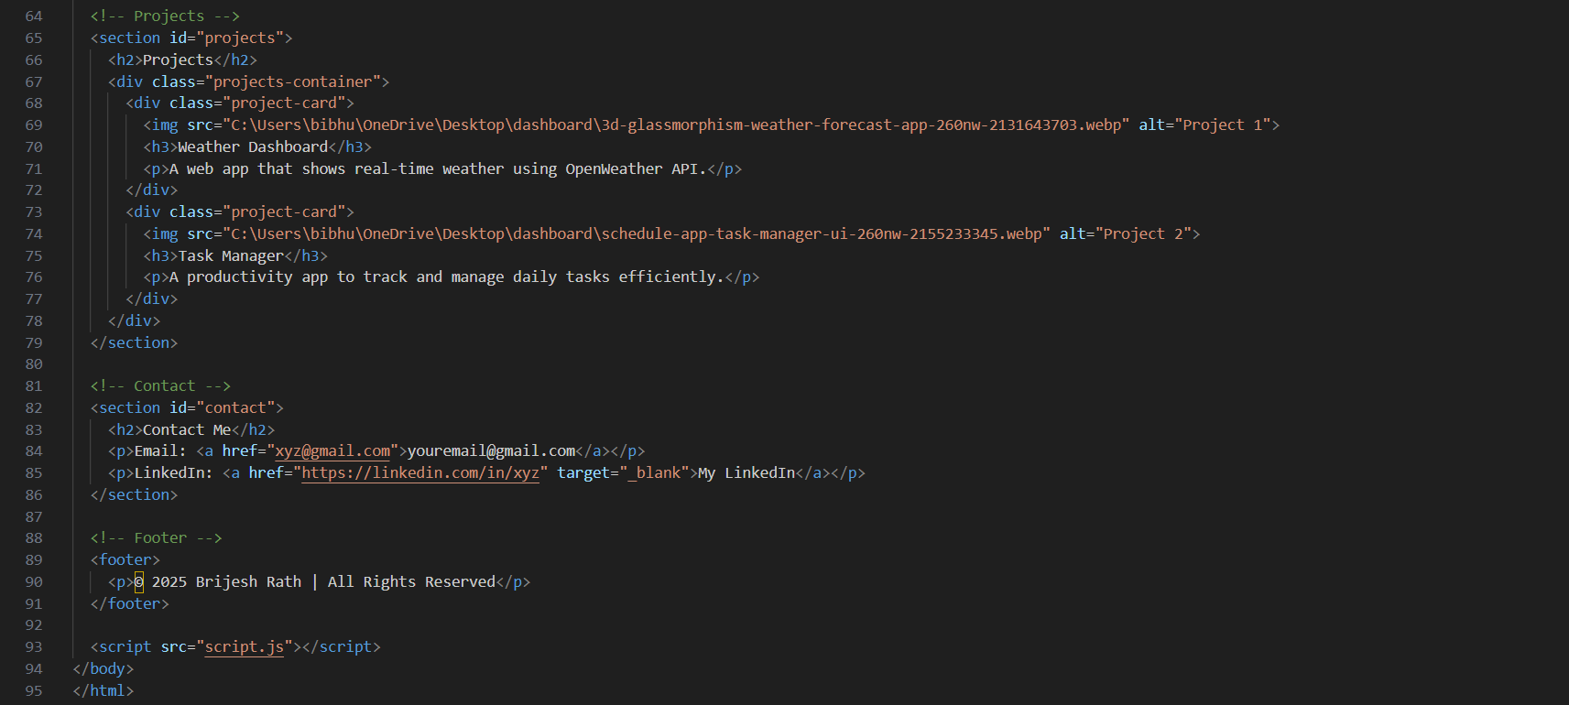
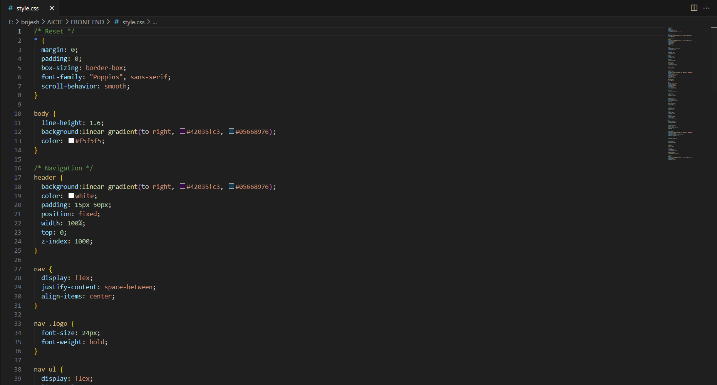
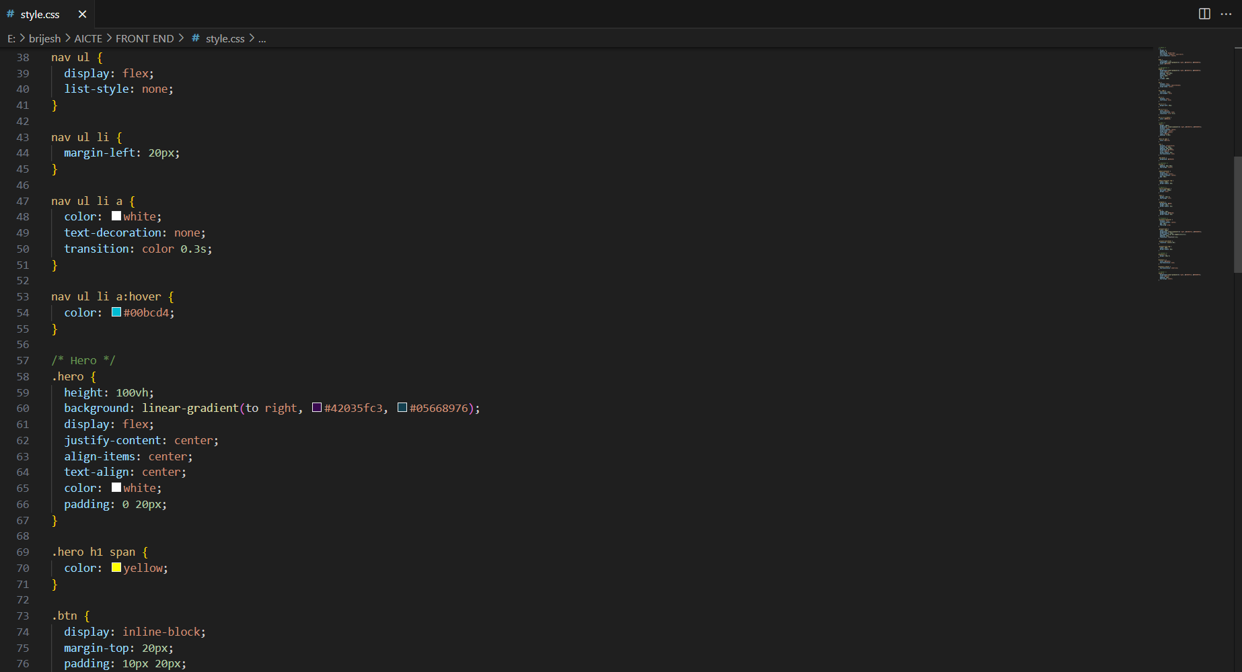
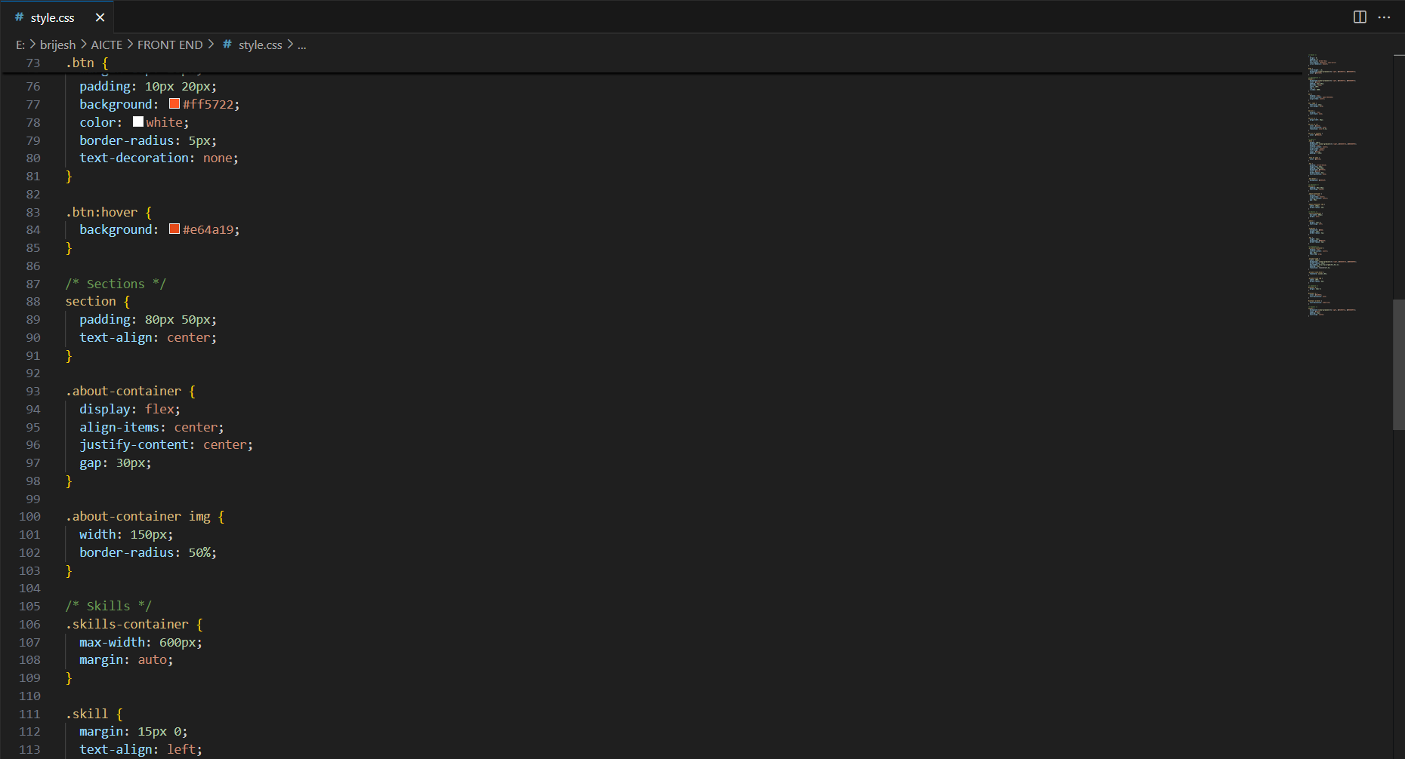
Result

Slide 7
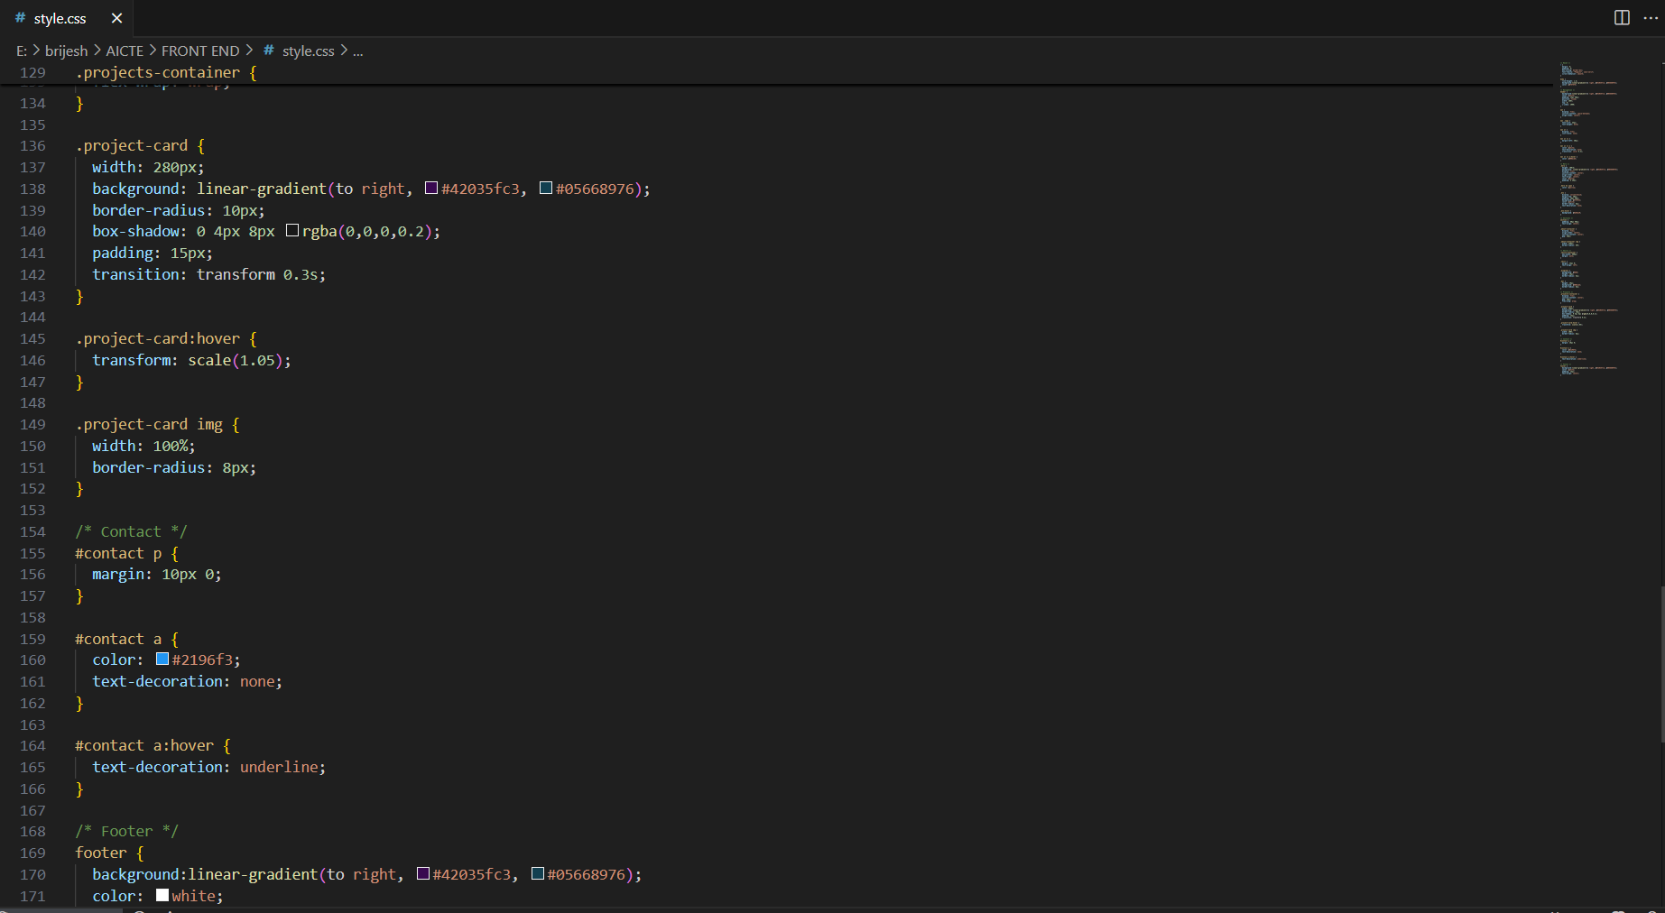
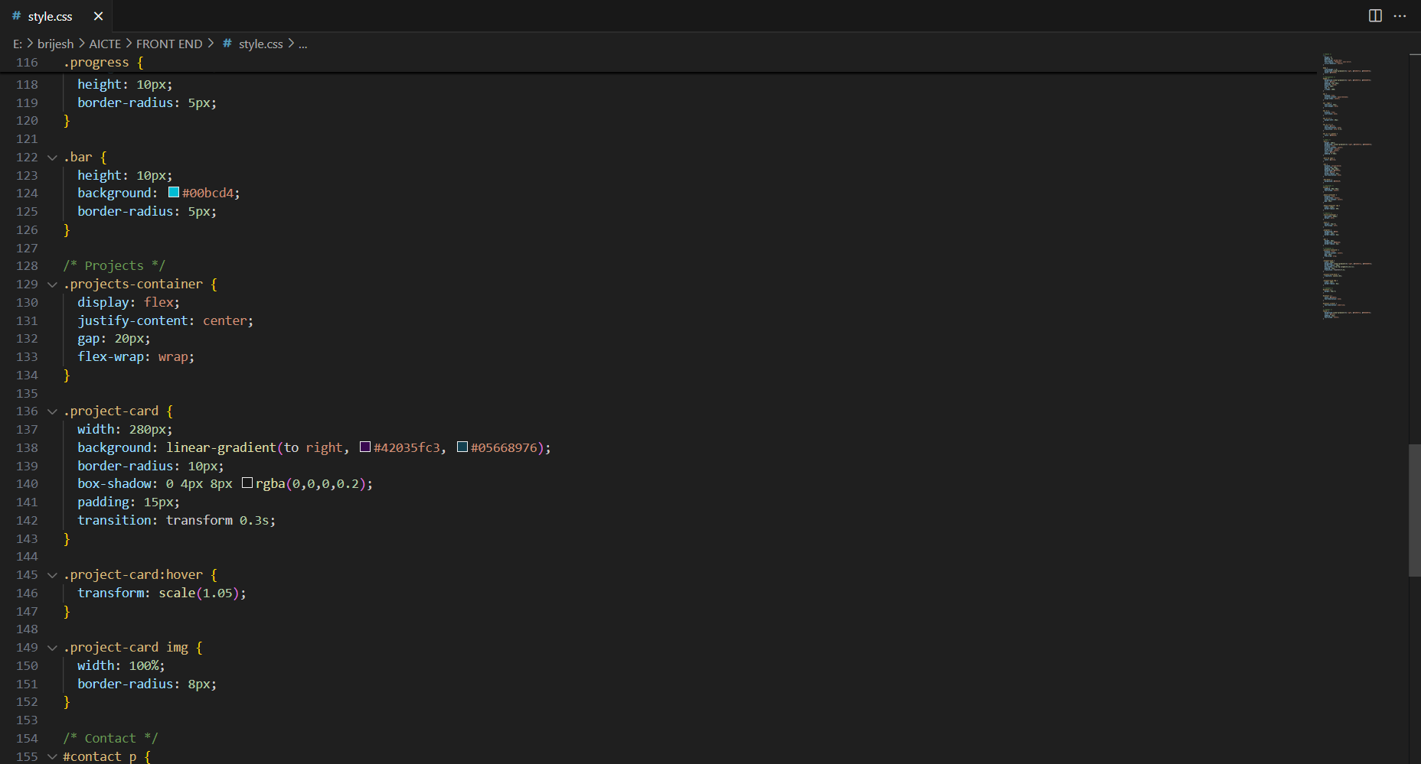
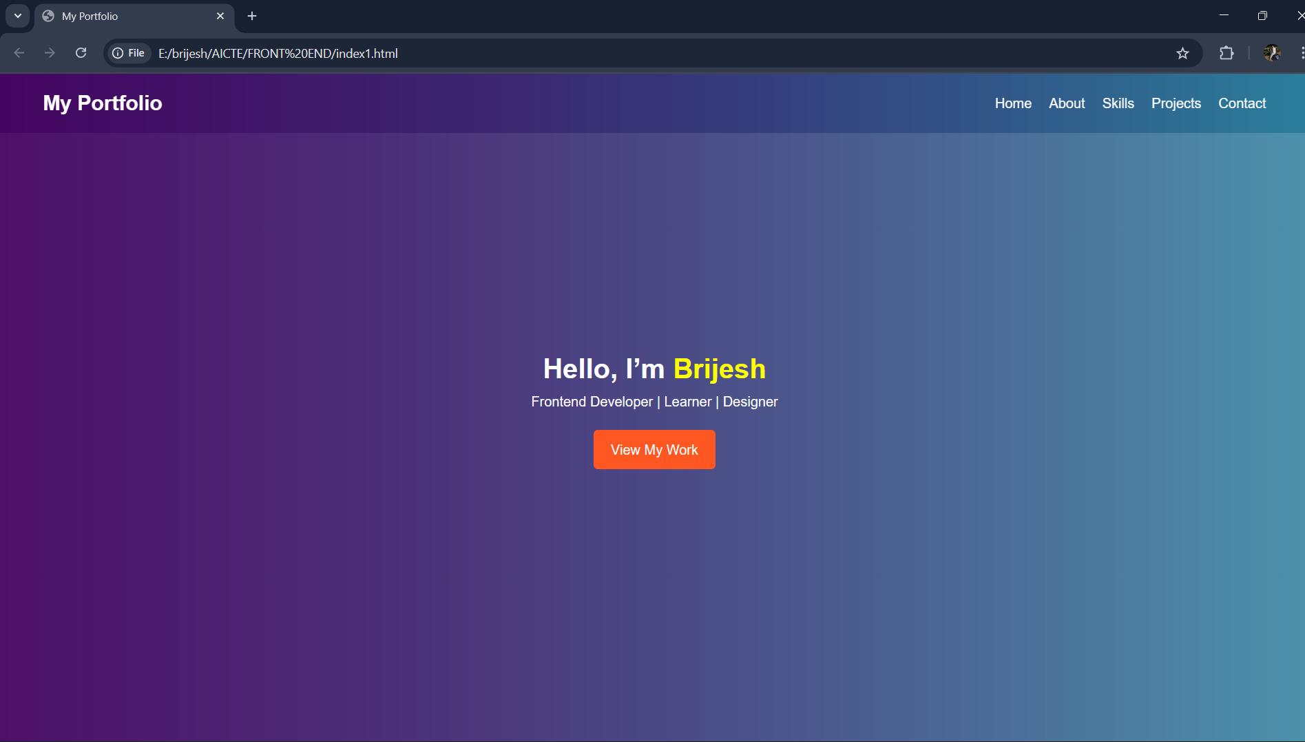
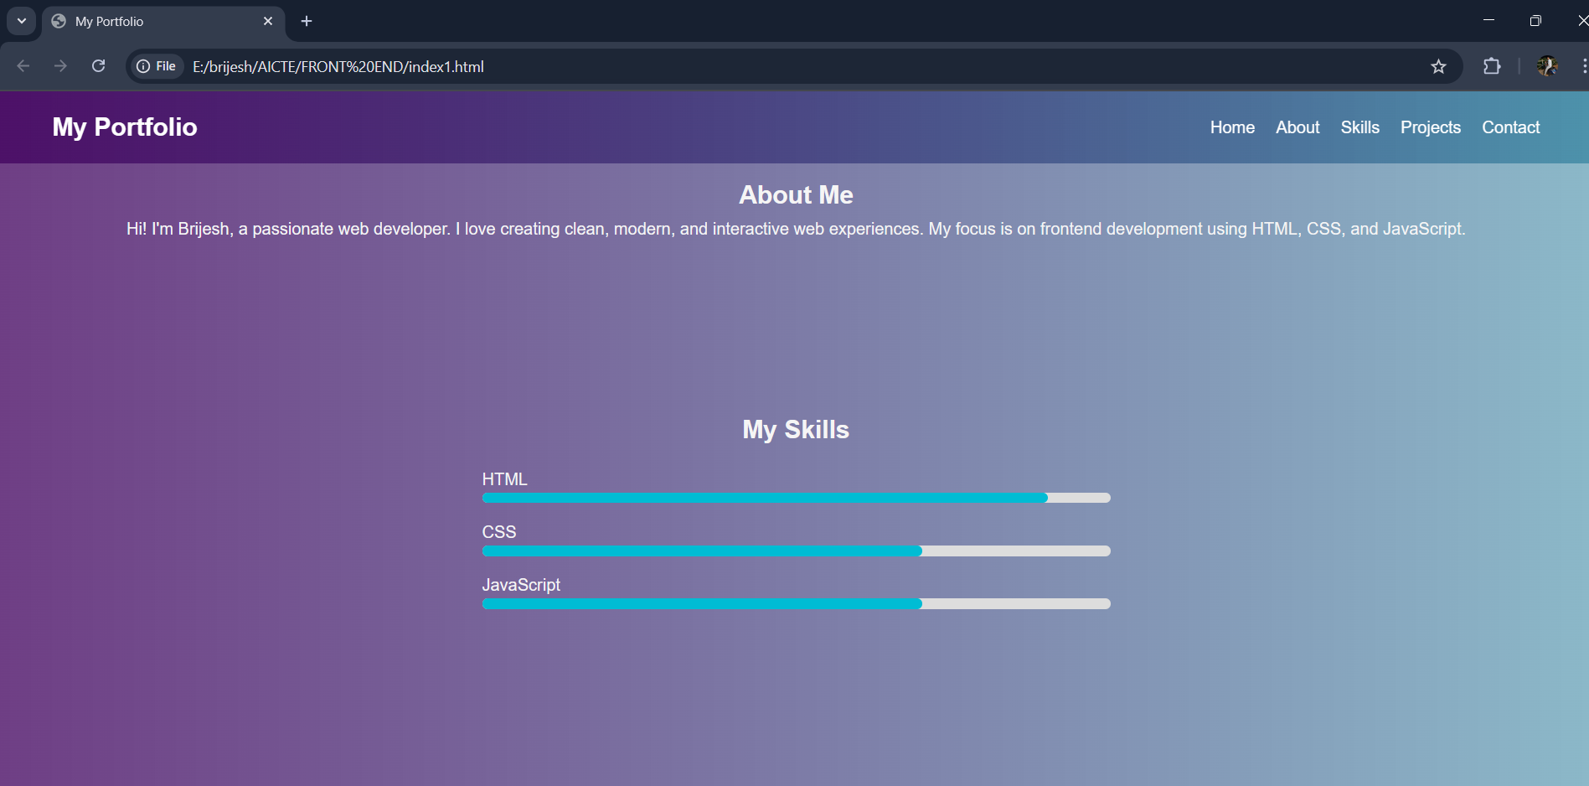
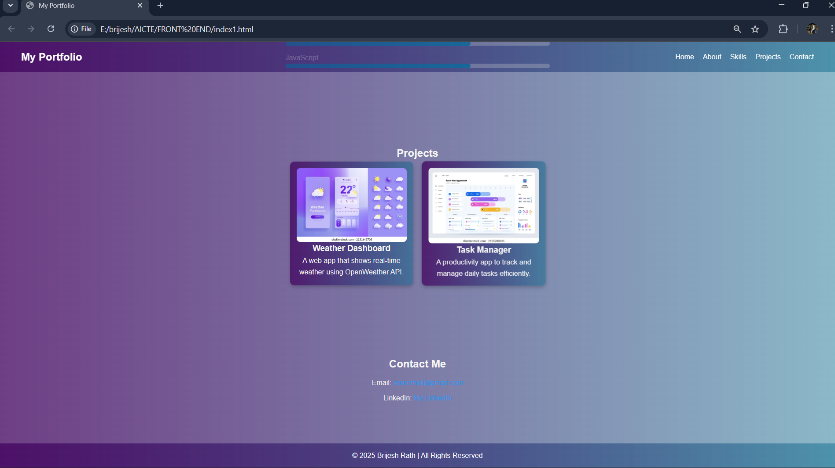
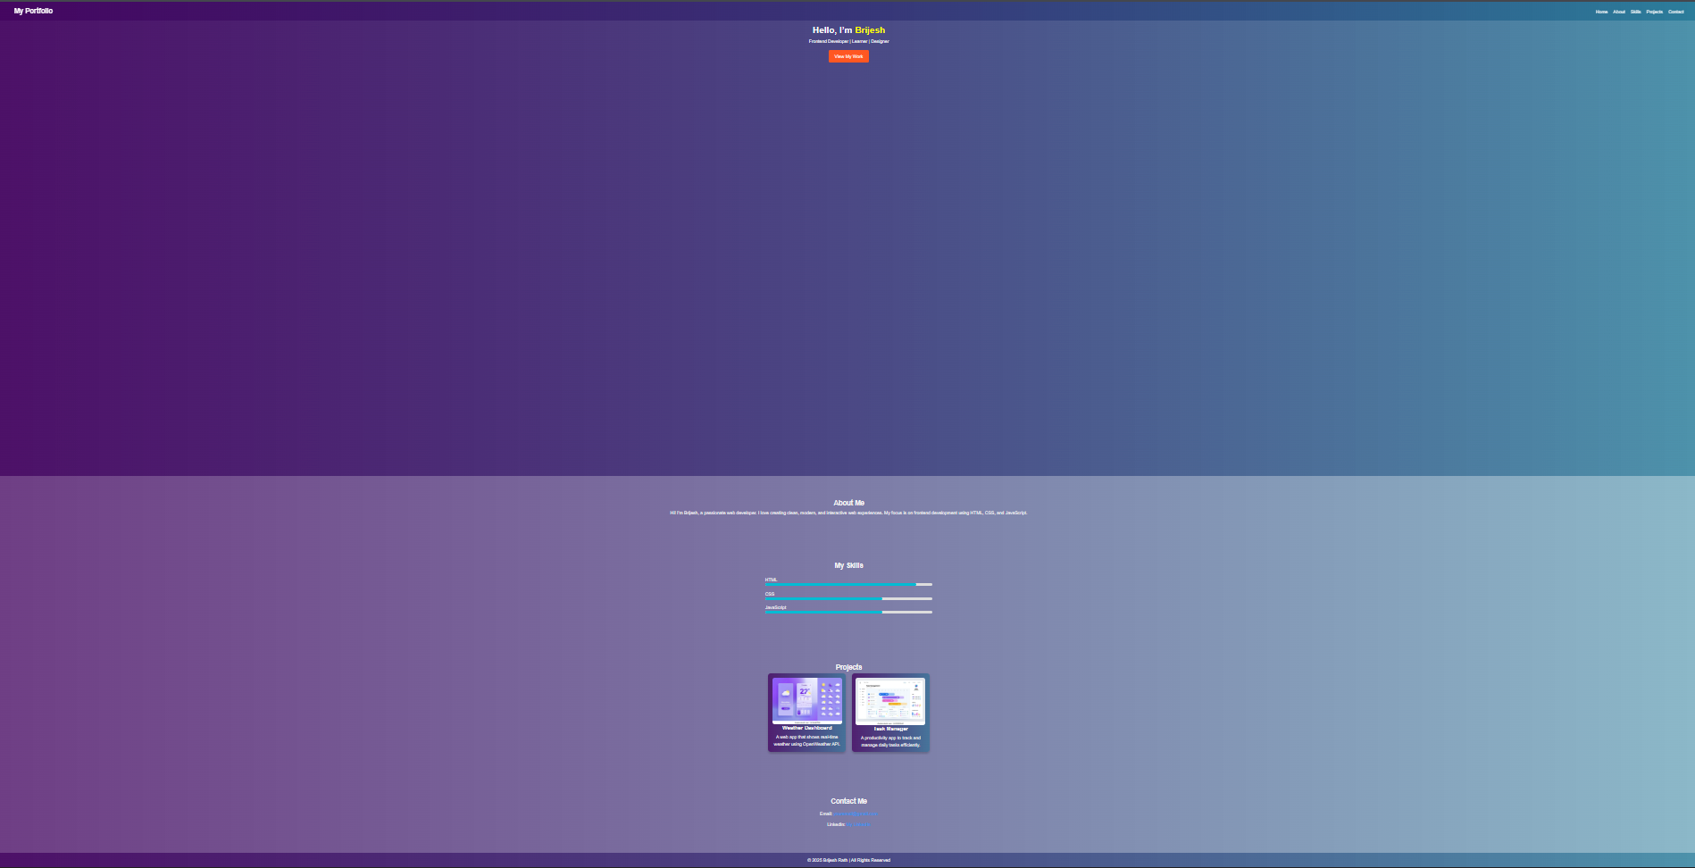
Result
GITHUB REPO LINK : https://github.com/Brijeshrath67/INTERACTIVE-PERSONAL-PORTFOLIO-WEBSITE.git

Slide 8
Conclusion
Developed a fully functional Interactive Personal Portfolio Website.
Successfully replaced the limitations of traditional, static resumes.
Presented personal details, skills, and projects in a structured way.
Implemented responsive design for access on multiple devices.
Enhanced user experience with animations and smooth navigation.
Improved technical skills in HTML, CSS, and JavaScript.
Understood the importance of personal branding in the digital era.
Website can be further extended with resume download and contact form.

Slide 9
Future scope(Optional)
Add a downloadable resume button for recruiters.
Integrate a contact form with email notifications.
Include a dark/light mode toggle for better user preference.
Add blog section or achievements section to showcase updates.
Enable project live demo links for better portfolio presentation.
Improve with advanced animations and transitions.
Implement multi-language support for wider accessibility.
Enhance SEO optimization for better online visibility.

Slide 10
References
W3Schools – HTML Tutorial
W3Schools – CSS Tutorial
W3Schools – JavaScript Tutorial
Google Fonts – Montserrat & Poppins
MDN Web Docs – Responsive Web Design Basics
GitHub Docs – Getting Started with GitHub Pages

Slide 11
THANK YOU

